Slide 1

Chapter 12 Part 1
Distributed Database Management Systems
The slides in this presentation have been adapted from slides provided with the textbook, Database Systems: Design, Implementation, and Management,
12E, Cornel and Morris, Copyright © 2017 Cengage Learning.

Slide 2
Learning Objectives
What are distributed database management systems (DDBMSs) and their components
How database implementation is affected by different levels of data and process distribution
Copyright © 2017 Cengage Learning
2

Slide 3
The Evolution of Distributed Database Management Systems
Distributed database management system (DDBMS)
Governs storage and processing of logically related data
Interconnected computer systems
Both data and processing functions are distributed among several sites
Centralized database required that corporate data be stored in a single central site
Copyright © 2017 Cengage Learning
3

Slide 4
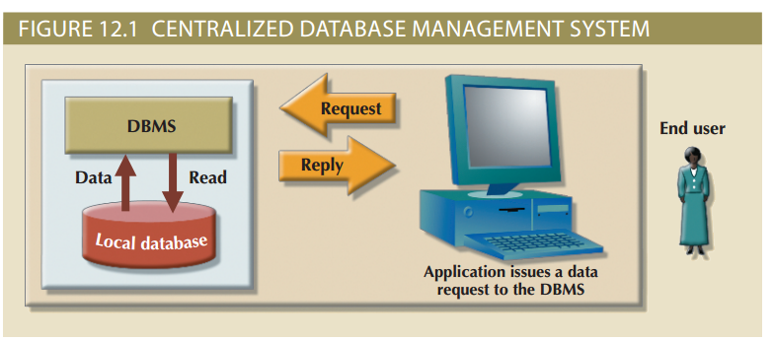
Centralized Database Management System
Copyright © 2017 Cengage Learning
4

Slide 5
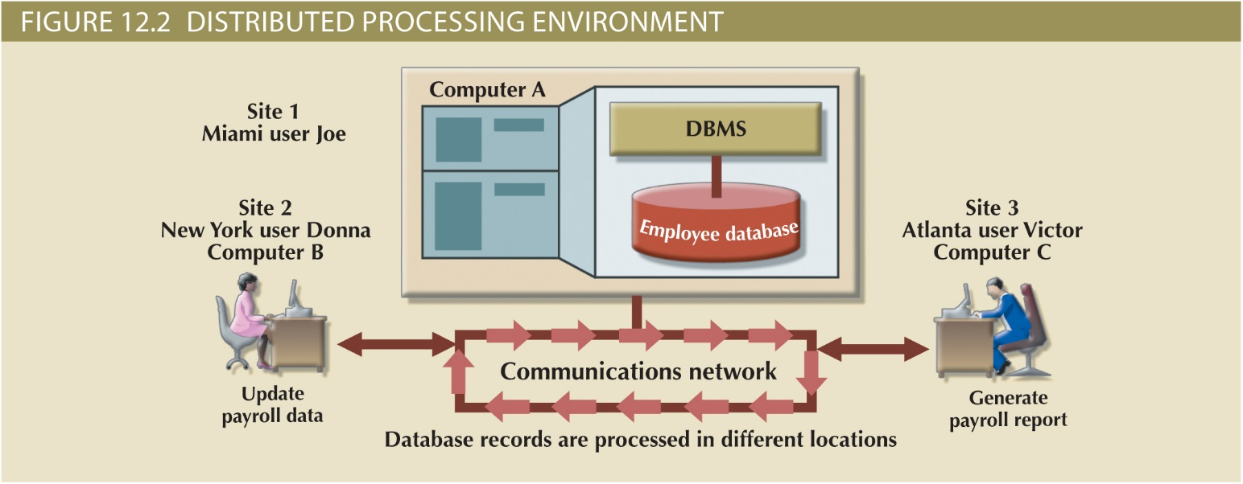
A Fully Distributed Database Management System
Copyright © 2017 Cengage Learning
5

Slide 6
Factors Affecting the Centralized Database Systems
Globalization of business operation
Advancement of web-based services
Rapid growth of social and network technologies
Digitization resulting in multiple types of data
Innovative business intelligence through analysis of data
Copyright © 2017 Cengage Learning
6

Slide 7
Factors That Aided DDBMS to Cope With Technological Advancement
Acceptance of Internet as a platform for business
Mobile wireless revolution
Usage of application as a service
Focus on mobile business intelligence
Copyright © 2017 Cengage Learning
7

Slide 8
Desirability of Distributed DBMS Over Centralized DBMS
Performance degradation
High costs
Reliability problems
Scalability problems
Organizational rigidity
Copyright © 2017 Cengage Learning
8

Slide 9
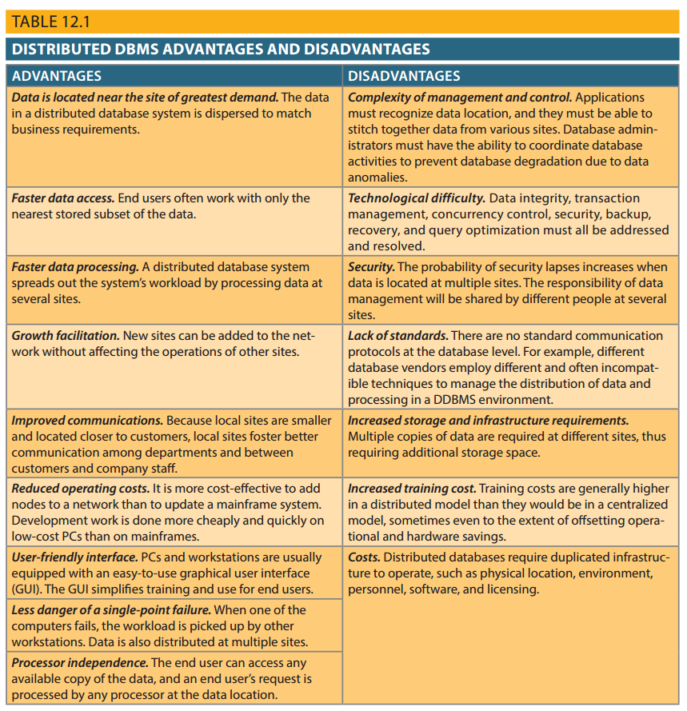
Copyright © 2017 Cengage Learning
9

Slide 10
Distributed Processing and Distributed Databases
Distributed processing
Database’s logical processing is shared among two or more physically independent sites
Connected through a network
Distributed database
Stores logically related database over two or more physically independent sites
Database composed of database fragments
Copyright © 2017 Cengage Learning
10

Slide 11
Functions of Distributed DBMS
Receives the request of an application
Validates analyzes, and decomposes the request
Maps the request
Decomposes request into several I/O operations
Searches and validates data
Ensures consistency, security, and integrity
Validates data for specific conditions
Presents data in required format
Copyright © 2017 Cengage Learning
11

Slide 12
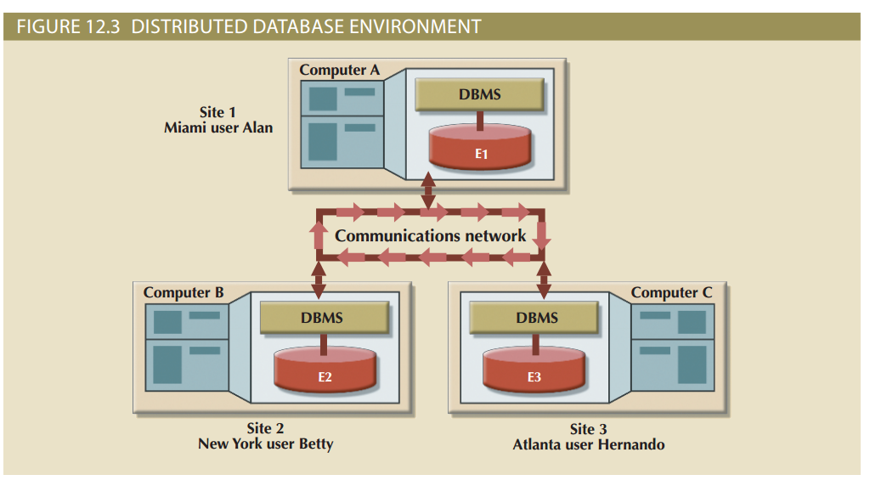
Copyright © 2017 Cengage Learning
12

Slide 13
Characteristics of Distributed Management Systems
Application interface
Validation
Transformation
Query optimization
Mapping
I/O interface
Copyright © 2017 Cengage Learning
13

Slide 14
Characteristics of Distributed Management Systems
Formatting
Security
Backup and recovery
DB administration
Concurrency control
Transaction management
Copyright © 2017 Cengage Learning
14

Slide 15
Characteristics of Distributed Management Systems
Must perform all the functions of centralized DBMS
Must handle all necessary functions imposed by distribution of data and processing
Must perform these additional functions transparently to the end user
Copyright © 2017 Cengage Learning
15

Slide 16
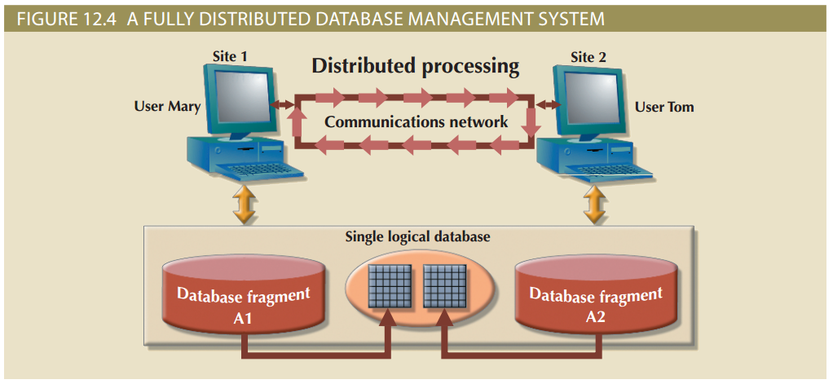
Copyright © 2017 Cengage Learning
16

Slide 17
DDBMS Components
Computer workstations or remote devices
Network hardware and software components
Communications media
Transaction processor (TP): Software component of a system that requests data
Also known as transaction manager (TM) or application processor (AP)
Data processor (DP) or data manager (DM)
Software component on a system that stores and retrieves data from its location
Copyright © 2017 Cengage Learning
17

Slide 18
Single-Site Processing, Single-Site Data (SPSD)
All processing is done on single CPU or host computer (mainframe, midrange, or PC)
All data are stored on host computer’s local disk
Processing cannot be done on end user’s side of system
Typical of most mainframe and midrange computer DBMSs
DBMS is located on host computer, which is accessed by dumb terminals connected to it
Copyright © 2017 Cengage Learning
18

Slide 19
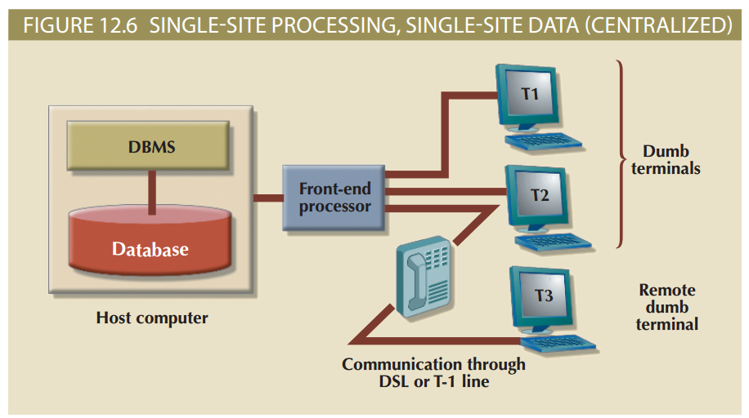
Figure 12.6 - Single-Site Processing, Single-Site Data (Centralized)
Copyright © 2017 Cengage Learning
19

Slide 20
Multiple-Site Processing, Single-Site Data (MPSD)
Multiple processes run on different computers sharing a single data repository
Require network file server running conventional applications
Accessed through LAN
Client/server architecture
Reduces network traffic
Processing is distributed
Supports data at multiple sites
Copyright © 2017 Cengage Learning
20

Slide 21
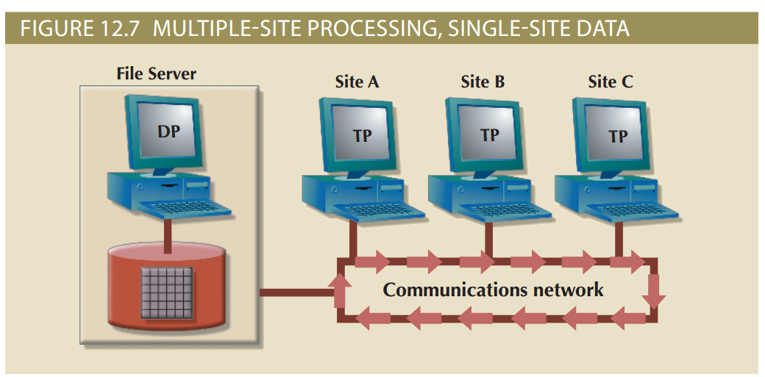
Figure 12.7 - Multiple-Site Processing, Single-Site Data
Copyright © 2017 Cengage Learning
21

Slide 22
Multiple-Site Processing, Multiple-Site Data (MPMD)
Fully distributed database management system
Support for multiple data processors and transaction processors at multiple sites
Classified as either homogeneous or heterogeneous
Homogeneous DDBMSs
Integrate only one type of centralized DBMS over a network
Copyright © 2017 Cengage Learning
22

Slide 23
Multiple-Site Processing, Multiple-Site Data (MPMD) (cont’d.)
Heterogeneous DDBMSs
Integrate different types of centralized DBMSs over a network
Fully heterogeneous DDBMSs
Support different DBMSs
Support different data models (relational, hierarchical, or network)
Different computer systems, such as mainframes and microcomputers
Copyright © 2017 Cengage Learning
23

Slide 24
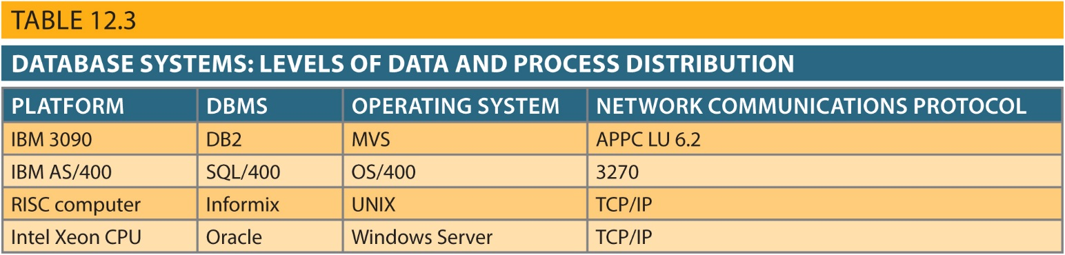
Distributed Database Software
Copyright © 2017 Cengage Learning
24

Slide 25
Summary
Homogeneous distributed database system
Integrates one type of DBMS over computer network
Heterogeneous distributed database system
Integrates several types of DBMS over computer network
The design of distributed database must consider fragmentation and replication of data
Horizontal and vertical fragmentation
Copyright © 2017 Cengage Learning
30

Slide 26
Task
Describe the difference between Homogeneous and Heterogeneous distributed database systems.
Copyright © 2017 Cengage Learning
31

